Slide 1
SQL Server Permissions and Security Principals
SQLSAT CLUTCH CITY 2015
William Assaf
Sparkhound, Inc.

Slide 2
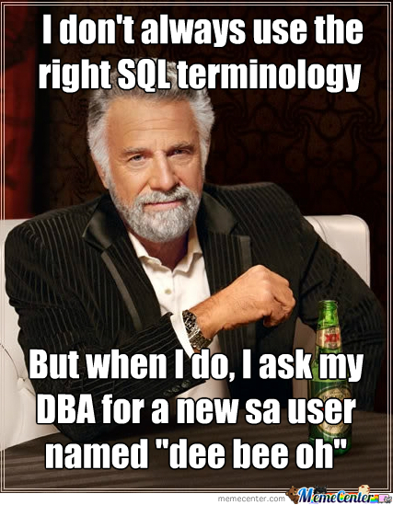
Why THIS topic?
This is a ground-floor introduction for anyone who interacts with SQL Server.
SQL Admins and Developers
Business Intelligence Developers
.NET Developers
Sysadmins

Slide 3
Why is this important?
Proper implementation of SQL Server security principals:
Decreases administrative effort
Decreases application complexity
Decreases database surface area
Listen during this presentation for real-world applications of this knowledge, and feel free to ask questions or chime in

Slide 4
Important acronyms
PEBKAC
PICNIC
ID-10-T
Problem Exists Between Keyboard and Chair
Problem in Chair, Not in Computer
Did you know that 90% of Security incidents are still caused by PEBKAC, PICNIC and ID-10-T errors?

Slide 5
Login vs user
Database User
Set a database context
Linked to a Server Login
Does not have a password
Assigned to Database Roles
Stored in the User Database
Brought along with a User DB Restore
Given access to SELECT, ALTER, EXECUTE, CREATE TABLE
Server Login
Connect to a SQL Server
Can be linked to AD (Windows)
Can have a password (SQL)
Assigned to Server Roles
Stored in the Master database
Not affected by User DB Restore
Given access to BACKUP, RESTORE, CONNECT, CREATE DATABASE

Slide 6
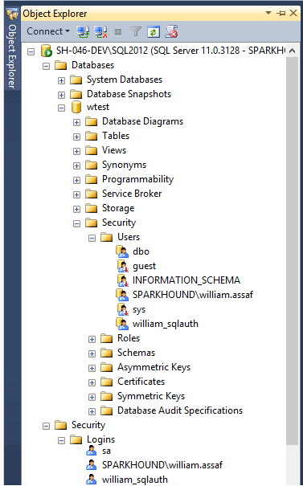
Database User
Set a database context
Linked to a Server Login
Does not have a password
Assigned to Database Roles
Stored in the User Database
Brought along with a User DB Restore
Given access to SELECT, ALTER, EXECUTE, CREATE TABLE
Server Login
Connect to a SQL Server
Can be linked to AD (Windows Login)
Can have a password (SQL Login)
Assigned to Server Roles
Stored in the Master database
Not affected by User DB Restore
Given access to BACKUP, RESTORE, CONNECT, CREATE DATABASE

Slide 7
Logins
A SQL server Login is a server-level security principal.
Logins are given a default database.
CONNECT will fail if the Default Database is not accessible.
Best practice- set Default Database to master.
In order to access data in a database, must be linked to a Database User.

Slide 8
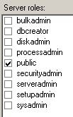
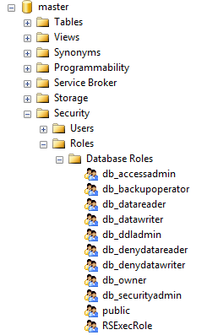
Server Roles
Roles are security principals that can grant permissions to other security principals.
Logins are added to Server Roles
Users are added to Database Roles
Built-in Roles to provide a standard for access.
Assign more specific permissions when possible.

Slide 9
Windows vs SQL Auth
Remember, a Login is what authenticates the user to the SQL Server instance, not a User.
In a typical business environment,
Windows Authentication means that
account creation/termination,
security group membership,
password policy,
are handled by an existing corporate security administration infrastructure.

Slide 10
Windows vs SQL Auth
Windows Authentication is the default security model for SQL Server and cannot be disabled.
The Windows Authentication model creates Server Logins that are linked to Local Windows or Domain Accounts
Preferably linked to AD Security Groups,
not individuals, so this membership is also managed by existing security infrastructure.
Choosing Mixed Mode as a server option enables SQL Logins and allows the “sa” account to be enabled.

Slide 11
On the topic of Groups…
Always assign permissions to AD groups, insist on it.
BUT
Be aware of who is a member of those groups, and what groups are a member of those groups you’re granting access to, and what groups are a member of those groups, and what groups are a member of those groups…
Devs -> App Support -> QA -> Financial Analysts…

Slide 12
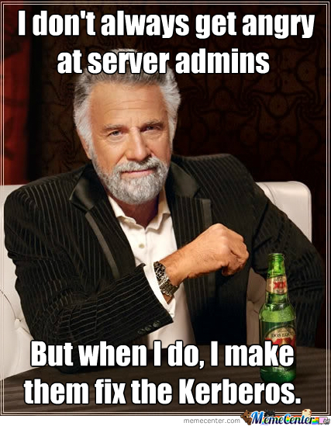
Apps + windows auth
From an Internet-facing server, Kerberos may be required to authenticate a Windows User directly from the application server to the SQL Server.
Can increase the complexity of an application loadout, but this is the Enterprise approach.

Slide 13
Server logins
Commonly requested Server Logins permissions:
(for non sysadmins)
ALTER TRACE For SQL Profiler and traces.
VIEW SERVER STATE For some server-level DMV’s
VIEW ANY DEFINITION For definitions of objects
These permissions are given by the GRANT syntax
GRANT VIEW SERVER STATE TO [SPARKHOUND\william.assaf];

Slide 14

Sql logins
SQL Logins are authenticated by SQL Server.
Strongly encouraged to Enforce password policy, which can include password expiration, inheriting from the same settings in Windows.
Multiple failed SQL auth login attempts will Lock Out.

Slide 15
Database users
Remember, a Server Login is what authenticates a user connection to the SQL Instance.
A Database User provides a Login with database access.
“Login” is a server level security principal.
“User” is a database level security principal.

Slide 16
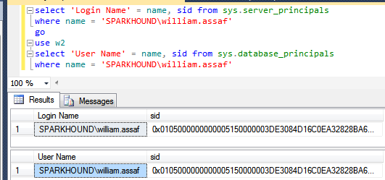
users
A User can be linked to any Server Login – the names don’t actually have to match.
Users have a sid (SID (Security-IDentifier) which is shared by the linked Login.

Slide 17
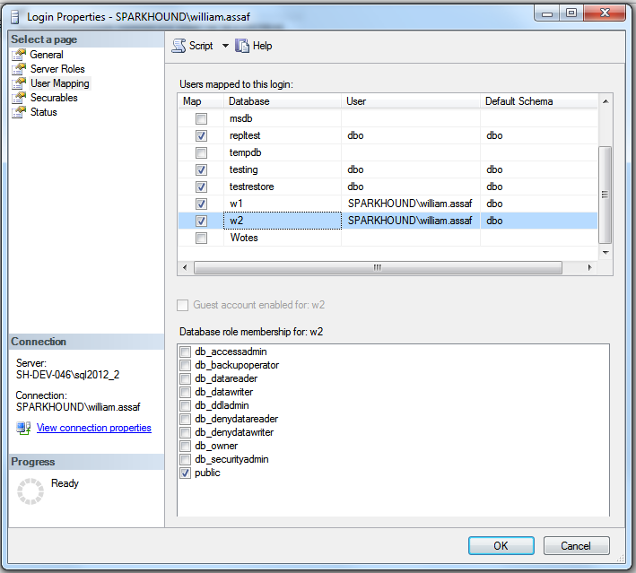
users
Logins are mapped to Users in the User Mapping page of the Login properties dialog.

Slide 18
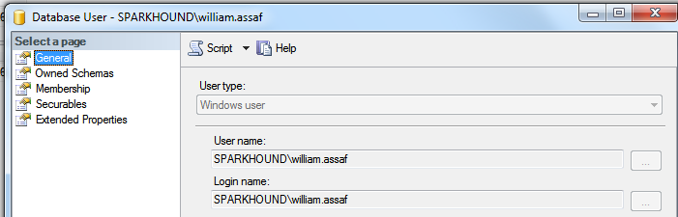
users
The mapping can be verified on the General page of the User properties dialog.

Slide 19
Orphaned sid
SQL Auth Logins can become disconnected from their Database Users when a database is restored from another server.
Only occurs with SQL Authenticated Logins, not Windows Authenticated Logins
Commonly occurs when a database is restored from one server to another
To re-associate a database user to a server login:
ALTER USER username WITH LOGIN = loginname;

Slide 20
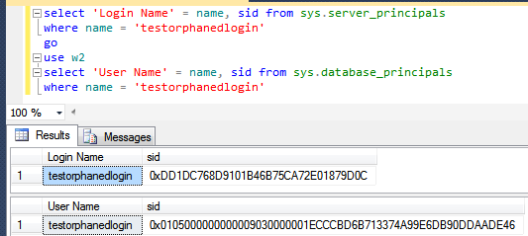
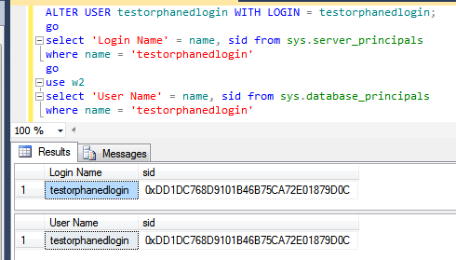
Fix orphaned sid
Fix: SQL Auth Login becomes disconnected from its Database User

Slide 21
Sql login migration
It is not possible to reverse-engineer a SQL Authenticated Login’s password.
When migration applications from one SQL Server instance to another, migration of SQL Logins is accomplished by:
Backup+restore of the master database
Creating matching SQL Logins with new password
Generating a hash of the password (but not the password itself): http://support.microsoft.com/kb/918992

Slide 22
Basic user permissions
DML*
SELECT
DELETE
UPDATE
INSERT
REFERENCES
*Data Manipulation Language
DDL*
ALTER
CONTROL
VIEW DEFINITION
CREATE
DROP
EXECUTE
*Data Definition Language
Modify Security
GRANT
REVOKE
DENY
IMPERSONATE

Slide 23
Basic user permissions
Example Scenario:
GRANT SELECT ON game.PingPongScores TO [PINGDOM\FGump];
GRANT EXECUTE ON game.spGetPingPongScore TO [PINGDOM\FGump];
GRANT EXECUTE TO [PINGDOM\FGump]; --current database context
GRANT VIEW DEFINITION ON game.spGetPingPongScore TO [PINGDOM\FGump];
GRANT ALTER TRACE TO [PINGDOM\FGump];
GRANT VIEW SERVER STATE TO [PINGDOM\FGump];

Slide 24
Stored procedures
Stored procedures require EXECUTE to run, and do not require all underlying object permissions (SELECT, INSERT, DELETE)…
…provided that the sproc doesn’t perform IDENTITY_INSERT on a table, which requires ALTER permissions not abstracted.
…provided that all the underlying objects have the same ownership chain.
…provided that the stored procedures do not use dynamic sql commands exec sp_executesql @SQL or EXEC(@SQL)

Slide 25
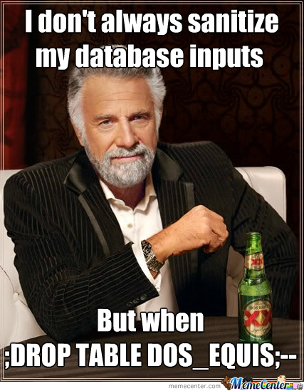

Slide 26

https://xkcd.com/327/

Slide 27
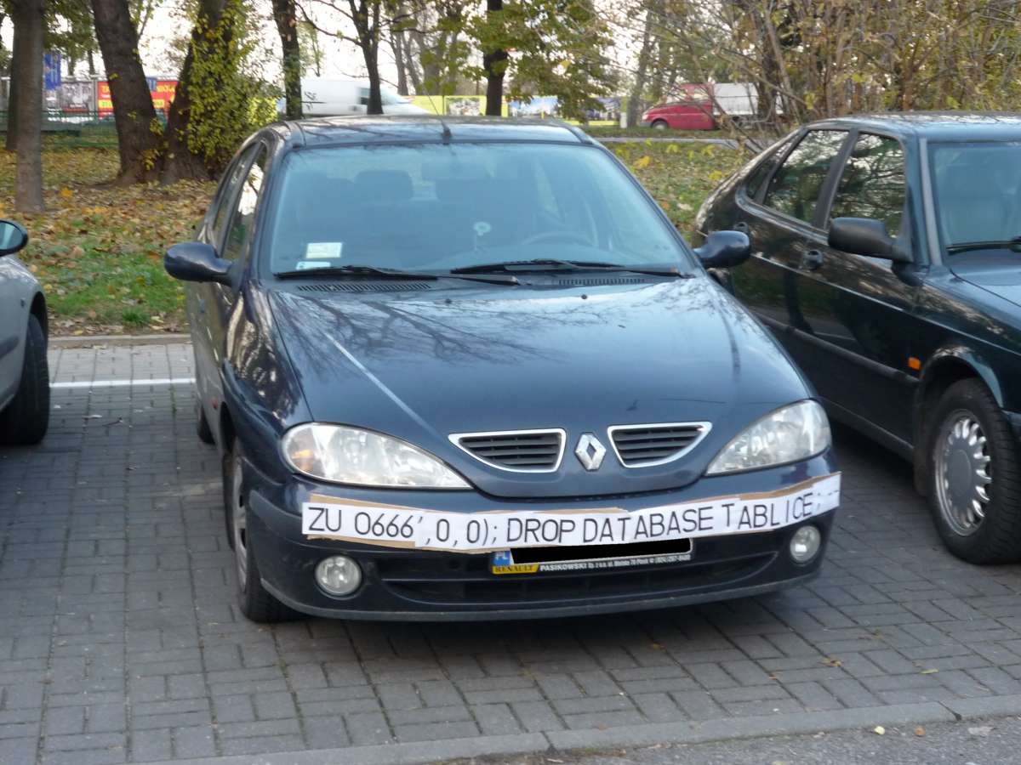

Slide 28
Stored procedures
Given those conditions, thanks to the database permission chain, you can
GRANT EXEC rights to sprocs that INSERT UPDATE and SELECT from a table.
GRANT no other permissions to the table!
The user can read data in the table using the sproc ONLY.

Slide 29
Stored procedures
Consider DENYing SELECT rights to the public role, which is inherited by all user roles aside from db_owner and sysadmin.
Users will be prevented from accessing any tables or views directly, from any application (SSMS, Access, Excel!).
User access to data is forced through your stored procedures.

Slide 30
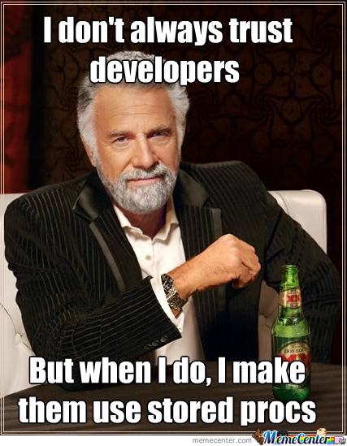
Stored procedures

Slide 31
Views
Similar to stored procedures, a VIEW will allow a user to SELECT data from tables that the user does not have access to.
Views are provisioned similarly to Tables and can even be UPDATEable (UPDATE, INSERT, DELETE) in the following conditions:
The view references only a single table.
No aggregations, UNION, distinct, GROUP, TOP
In this way, views can be used to expose a vertically-partitioned version of a table.

Slide 32
lab
Demonstrate how Stored Procedures and Views abstract the permissions necessary to view underlying table data.
Security p1.sql
Security p2.sql

Slide 33


And now for Something
completely different

Slide 34
Builtin\administrators
Prior to SQL 2008, [BUILTIN\Administrators] was a member of the SQL sysadmin role.
This was a security hole – allowing anyone who gained admin access to a Windows Server to automatically and easily have sysadmin access.
SQL 2008 – BUILTIN\Administrators no longer have automatic rights to the SQL server and should NOT be granted access.

Slide 35
schemabinding
CREATE VIEW dbo.Paddles WITH SCHEMABINDING AS…
Prevents underlying tables and views from ALTER or DROP. The statements fail, preventing the VIEW from silently breaking.
Underlying objects referenced must use 2-part format: [schema.objectname]
You can’t SCHEMABIND across databases.
SELECT * is not allowed in schema-bound objects.
Without SCHEMABINDING, you might have to exec sp_refreshview

Slide 36
dbo
In SQL 2000, sales.dbo.customers meant:
databasename = sales
owner = dbo
tablename = customers
In 2005 and later, sales.dbo.customers meant:
databasename = sales
schema name = dbo
tablename = customers

Slide 37
dbo
In SQL 2000, dbo was a special user inside each database with sysadmin permissions, which by default owned any object created by an admin. The dbo user could not be deleted.
In SQL 2005 and above, dbo is the default schema and no longer a security object. Saying a user has “dbo permissions” is incorrect.
[db_owner] is just a user role with no server-level permissions.

Slide 38
Schemas
A schema is a container of objects, by default objects are owned by internal “dbo” user.
Additional user schemas can be created. Permissions can be granted to schemas as a set.
Examples:
logical structuring [Staging], [ODS], [Audit], [WH]
business structuring [Sales], [HR], [Acct], [Inv]

Slide 39
schemas
Schemas can have owners and permissions to schemas can be granted to database principals.
For example:
CREATE SCHEMA [STAGING] AUTHORIZATION [ETLAdminUser];
CREATE TABLE [STAGING].[AuditLog] (…);
GRANT SELECT ON [STAGING] TO [ETLReadOnlyUser];

Slide 40
PUBLIC
Every login and user is a member of “public”.
Public is a server role that should never be granted any additional permissions, authorization or ownership.
Every database user/roles belongs to a public database role.
When a user has not been granted or denied specific permissions on a securable, the user inherits the permissions granted to public.

Slide 41
Cross database ownership
A sproc/view can return data from a table in another database without permissions, if the two databases share the same owner login, by enabling Cross-Database Ownership Chaining on both databases.
This is not enabled by default. It has to be enabled at the server level then activated in each database…

Slide 42
Cross database ownership
Any login can take advantage of Cross-Database Ownership Chaining from another database.
Stored procedures and views – not queries - can then query other databases without any additional permissions.
Which could be very helpful, or a security risk…

Slide 43
Cross database ownership
It is possible that cross-database ownership can bypass your permissions by querying from the context of another database!
Enabling Cross-Database Ownership Chaining increases the necessary complexity of securing your data with minimum permissions.
You don’t need it, do it right.

Slide 44
ownership
Microsoft is doing away with the terminology of Users or Logins “owning” objects, such as databases and schemas.
Changing the AUTHORIZATION is now the more accurate term to describe “ownership” of an object.
For example, sp_changedbowner is deprecated, replaced by
ALTER AUTHORIZATION

Slide 45
Application roles
By executing sp_setapprole, an application can give a user connection the permissions of an app role.
The application role has no permanent members, but is assigned permissions and given a app-only password.
The user connection assumes only the permissions of the application role.
Cons:
Accessing other databases requires the use of the guest role.
Connection pooling can be problematic (cookies)

Slide 46
Contained databases
Moves authentication from the Server level directly to the Database level.
A contained database owner, for example an Application owner, has full control over security in the database.
No server-level (or sysadmin) permissions necessary to administer a Contained Database.
The database has no configuration dependencies on the instance, it can be easily moved to another instance.

Slide 47
Contained databases
Authentication can be made with Windows Auth logins or Contained Database Users where the password is maintained in the database. No SQL Auth server logins.
Agent jobs, system error messages, linked server information, and system settings are all inside the ContainedDB instead of master or msdb.
Contained Databases simulate the isolation of SQL Azure databases. The Contained DB is a foundational piece of the SQL 2012 AlwaysOn Availability Groups feature.

Slide 48
Continued reading
http://blogs.msdn.com/b/sqlsecurity/
http://msdn.microsoft.com/en-us/library/ms144284(v=sql.110).aspx
http://msdn.microsoft.com/en-us/library/ms188908(v=sql.110).aspx
http://msdn.microsoft.com/en-us/library/ms190387.aspx
http://msdn.microsoft.com/en-us/library/ms191291.aspx
http://social.technet.microsoft.com/wiki/cfs-file.ashx/__key/communityserver-wikis-components-files/00-00-00-00-05/5710.Permissions_5F00_Poster_5F00_2008_5F00_R2_5F00_Wiki.pdf
http://msdn.microsoft.com/en-us/library/bb669058(v=VS.110).aspx
http://blogs.msdn.com/b/sqlsecurity/archive/2011/08/25/database-engine-permission-basics.aspx
http://msdn.microsoft.com/en-us/library/ms191465.aspx
http://blogs.msdn.com/b/sqlsecurity/archive/2011/08/26/data-hashing.aspx
http://www.sqlservercentral.com/blogs/steve_jones/2009/06/01/sql-server-encryption-hashing-collisions/
http://msdn.microsoft.com/en-us/library/ff929055(v=sql.110).aspx
http://msdn.microsoft.com/en-us/library/ff929071(v=sql.110).aspx
http://technet.microsoft.com/en-us/library/ms187359.aspx
http://support.microsoft.com/kb/918992

Slide 49

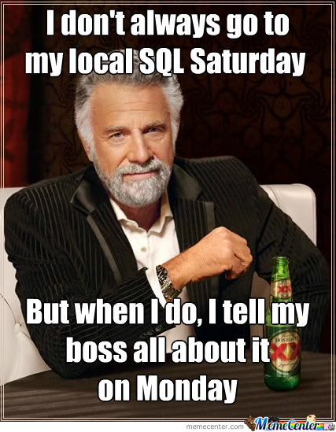

Slide 50


Thank You Sponsors!
Visit the Sponsor tables to enter their end of day raffles.
Turn in your completed Event Evaluation form at the end of the day in the Registration area to be entered in additional drawings.
Want more free training? Check out the Houston Area SQL Server User Group which meets on the 2nd Tuesday of each month. Details at http://houston.sqlpass.org

Slide 51
NEARBY USER COMMUNITY
Baton Rouge Area SQL Server User Group
brssug.org
Houston Area SQL Server User Group
houston.sqlpass.org
Houston Tech Fest
houstontechfest.com
Baton Rouge SQL Saturday
August 1 at LSU!
Sqlsaturday.com

Slide 52
Bio and contact
William D Assaf, MCSE
Past President, Baton Rouge SQL Server User Group
Principal Consultant, Team Lead at
Sparkhound Inc., William.Assaf@sparkhound.com
Twitter: @william_a_dba
This presentation, including all source code and this slide deck, has been posted at my blog:
SQLTact.com

